Slide 1


Department of Computer Science and Engineering
AUTOMATED RAILWAY SIGNALLING SYSTEM
USING HASH ALGORITHM
Girija A [211419101078]
Isnehashankar S [211419104108]
Linnet Blessy M [211419104147]
Guide Name & Designation
Coordinator Name & Designation
S.T Santhanalakshmi M.Tech.,
Dr. Kavitha Subramani M.E., PhD.,

Slide 2
Abstract
Human development is directly related to the transport facility. India has been starting its transport through railways since 19th century. The Indian railway system is very big and very complicated. When generation moves forward, the technology and complexity are also moves to its higher levels. Now days, there is no exact communication between Indian railways and passengers. So we introduce Automated Railway Signaling System (ARSS) which automatically collect the information about the Train. The movements of the train can be controlled based upon the signal which will be automatically generated by the system. In this system, we get the train's arrival time at the station with the help of an RTC and proximity sensor, update the information in the Java web application with the train's ID with the help of an RFID module. If another train arrives in the same track, it will automatically intimate the co-driver to allocate the track according to their availability in order to send to their respective platform, and also send updates to the co-driver with the help of a ZIGBEE transmitter. Then the Java web application will send Gmail to the persons who are logged into the web application. We are planning to provide a system to automatically collect the information about trains and make the schedule based on track availability.

Slide 3
Literature Survey
Year | Author Name | Paper Title | Methodology | Merits | Demerits
2022 | Hafeez Ur Rehman Siddiqui, Adil Ali Saleem, Muhammad Amjad Raza, Kainat Zafar, Kashif Munir, Sandra Dudley | Iot Based Railway Track Faults Detection And Localization Using Acoustic Analysis Volume-10 Issued On- 27 Sep 2022 Journal –IEEE | Acoustic Analysis and Localization Machine Learning Algorithms | This system would reduce human error, provide greater inspection ranges and accuracy and reduce overall labor costs. | It detects only few fault types that are mentioned.
2022 | Alan Shaju, Aravind Madhu , Doel Sam | Automated railway track crack detection system Volume -7 Issued On- 4 April 2022 Journal-IEEE | Crack Detection Using LED-LDR | This can be implemented in large scale to facilitate better safety standards for railway tracks in future. This will have a great impact on the safety and maintenance of tracks. This will help in preventing train accidents. | The system is designed in such a manner that the vehicle should not engage the train routine and should work on empty tracks

Slide 4
Literature Survey
Year | Author Name | Paper Title | Methodology | Merits | Demerits
2020 | Yanqiu Li, Xinyue Xu, Jianmin Li, Rui Shi | A Delay Prediction Model For High-Speed Railway Issued On-24 December 2020 Journal- IEEE Conference | An extreme learning machine (ELM) tuned via particle swarm optimization (PSO) is proposed to predict train arrival delays of HSR lines. | It can be used to guide the dispatchers to arrange the train transportation organization in case of delay problem. | Less accuracy in predicting train arrival delay.
2020 | Hamad Alawad, Sakdirat, Kaewunruen. | A Deep Learning Approach Towards Railway Safety Risk Assessment Volume –8 Issued On –27 May 2020 Journal -IEEE | Proposed an efficient railway system technique framework based on a CNN and applied DL algorithms to foster detection of unwanted events in railway stations | Improves safety and security throughout the entire railway industry paradigm. | The data availability and quality remain a challenge because this technology depend heavily on large amounts of high-quality data.

Slide 5
Literature Survey
Year | Author Name | Paper Title | Methodology | Merits | Demerits
2019 | Qi Zhang, Zhiming Yuan, Lu Yan, Tao Zhang, Yifeng Miao, Shuxin Ding | A Railway Train Number Tracking Method Using A Prediction Approach Volume-7 Issued On-25 SEP 2019 Journal -IEEE | Centralized traffic control (CTC)System, Hidden Markov model | Obtain the accurate real-time train number and location in a railway network. | Fault zone are created by more than two neighbour blocks and some trains are delayed more than the deviation compensations.
2018 | Y. Baviskar, U. Suryawanshi, A. Sheikh | Modelling of Track Layout for Intelligent Railway Signalling System: A Machine Learning Application Issued On- 10 DEC 2018 Journal-IEEE Conference | For modelling, IR standard single line station layout is considered and graphical model based design techniques are implied. | It not only provide safety but also it systematizes various methods & strategies such as rescheduling system, monitoring performance using ML | • The construction of ISS is a complicated task. • Due to the current technology limitation, which cannot match the intelligence & ﬂexibility of human beings, it is not possible to replace manual reporting made by humans with automatic reporting systems

Slide 6
Literature Survey
Year | Author name | Paper Title | Methodology | Merits | Demerits
2017 | DR.R.Velayutham, T.Sangeetharani, K.Sundaralakshmi. | Controlling Railway gates using smart phones by tracking trains with GPS Issued On-21 APR 2017 Journal -IEEE Conference | It works based on Internet of Things. Track and detect the arrival of the train by using GPS-(Global Positioning System) | Reduces the number of accidents and the manpower in the railway crossing. | This Android application can’t be used by the third party
2017 | Dr. F. Balouchi, Dr. A. Bevan, R. Formston | Detecting Railway Under-track Voids Using Multitrain In-service Vehicle Accelerometer Issued On- 08 May 2017 Journal- IEEE Conference | Signal Processing, Multi-Source Data Analysis | • Improving train safety, network reliability and passenger comfort. • Algorithms are used to predict with more accuracy the condition of large portions of the network at a high rate with low cost | • A voided sleeper is not able to support the vehicle axle load and does not transfer any force to the ballast layer. • Road crossing do not appear clearly in the data.
08-04-2023
6

Slide 7
Literature Survey
Year | AuthorName | Paper title | Methodology | Merits | Demerits
2016 | Sarngadi Palgunadi, Dian Supraba, Bambang Harijito | Job-shop Scheduling Model For Optimization Of The Double Track Railway Scheduling Issued On -12 Oct 2016 Journal –IEEE Conference | Neural Network , Ant Colony Optimization (ACO), Simulation Annealing, Greedy Job-shop , FCFC | •Scheduling trains in order to minimize the delay time. •Used to solve secondary delays to other trains in the network. | •The proposed scheduling model is not promising to solve the problem because the average delays are greater than the actual schedule although the number of delayed train are less. •Conflict among trains.
2014 | J.Guo, X.Wang, Y.Zhang, Y.Yang. | Future prospects on the intelligent monitoring technologies for Railway Signalling system Issued On-18 SEP 2014 Journal-IEEE Conference | Centralized signalling monitoring system (CSM) | •Used to overcome the problems involved such as interconnection, data sharing and intelligent analysis, an integrated scheme of the intelligent monitoring and maintenance system for RSS | •Need to pay attention to monitoring and maintenance of the management network security. •Strictly implement the safety protecting measures to prevent the invasion of the hackers and virus.

Slide 8
Problem Statement
In general, Railway system is the most commonly used transportation system especially in India. But due to miscommunication about the railway schedules and lack of coordination, accidents happen. And there is no exact communication between Indian railways and passengers. In this system, we get the train arrived time of the station and update the information to the webpage with the train id.

Slide 9
Proposed System
Here we choose RFID ,every train have a separate tag, reader is placed on a separate signal lamp post which is placed before a railway station in particular distance.
Inductive proximity sensor which placed nearly same location where reader placed, but our proximity sensor placed in track.
The reason we used this sensor is ,it only identifies the metal object so it avoids the false trigger.
Moreover, the message are passed to the passengers whether the train is arriving on-time or not. Loco Pilot also receive a mail to pass the train to another track if another train arrives in the same track.
We can update the arrived time of the train with train id.
This system updates the time with respected id of the train to the cloud.

Slide 10
Software / Hardware Used
HARDWARE REQUIREMENTS | SOFTWARE REQUIREMENTS
ARDUINO UNO ARDUINO MEGA POWER SUPPLY LCD DISPLAY PROXIMITY SENSOR RFID READER RFID TAG (5) BUZZER SERVO MOTOR RS232 RTC ZIGBEE PAIR | EMBEDDED C ARDUINO IDE JAVA ECLIPSE

Slide 11
Methodology Used
ALGORITHM USED:
Hashing:
It takes a piece of information and passes it through a function that performs mathematical operations on the plaintext.
This function is called the hash function, and the output is called the hash value/digest.
Secure Hash Algorithm (SHA-256):
SHA 256 is a part of the SHA 2 family of algorithms, where SHA stands for Secure Hash Algorithm.
Published in 2001, it was a joint effort between the NSA and NIST to introduce a successor to the SHA 1 family, which was slowly losing strength against brute force attacks.
The significance of the 256 in the name stands for the final hash digest value, i.e. irrespective of the size of plaintext/clear text, the hash value will always be 256 bits.

Slide 12
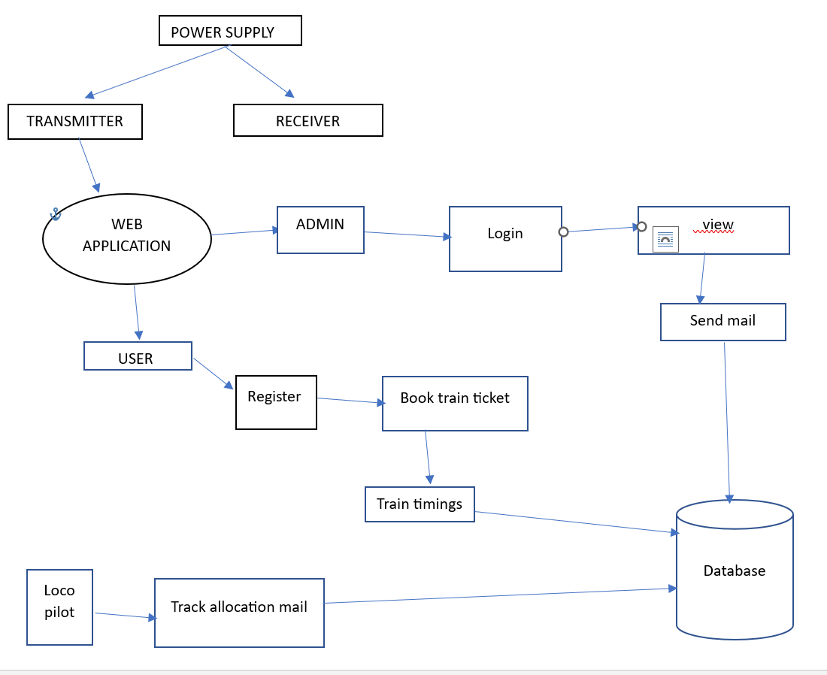
System Architecture

Slide 13
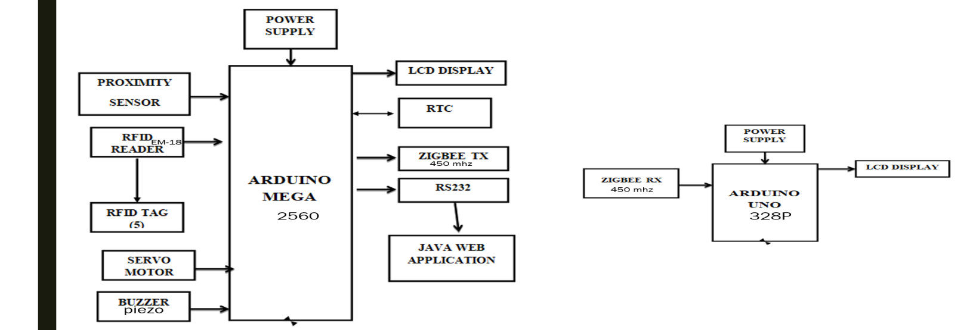

Hardware Architecture
Transmitter
Receiver

Slide 14
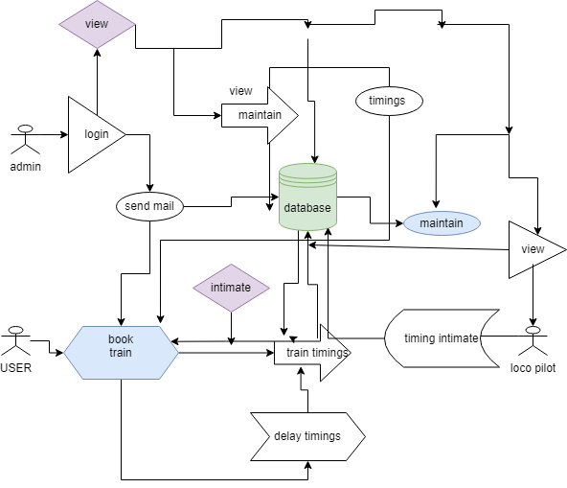
Software Architecture

Slide 15
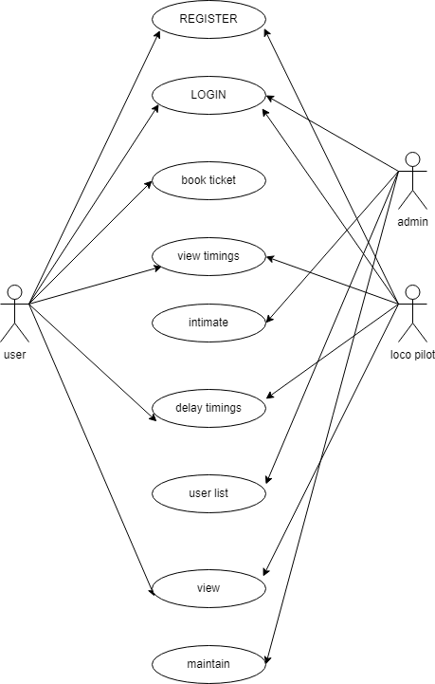
System Design – Use Case

Slide 16
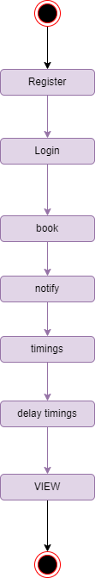
System Design – State Diagram

Slide 17
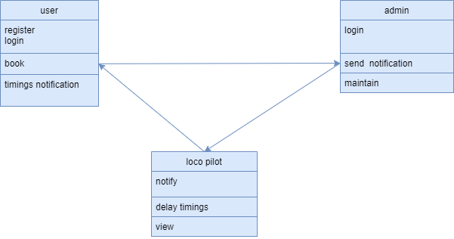
System Design – Class Diagram

Slide 18
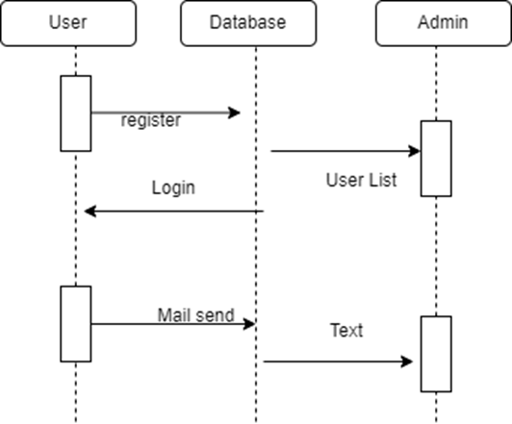
System Design - Sequence Diagram

Slide 19
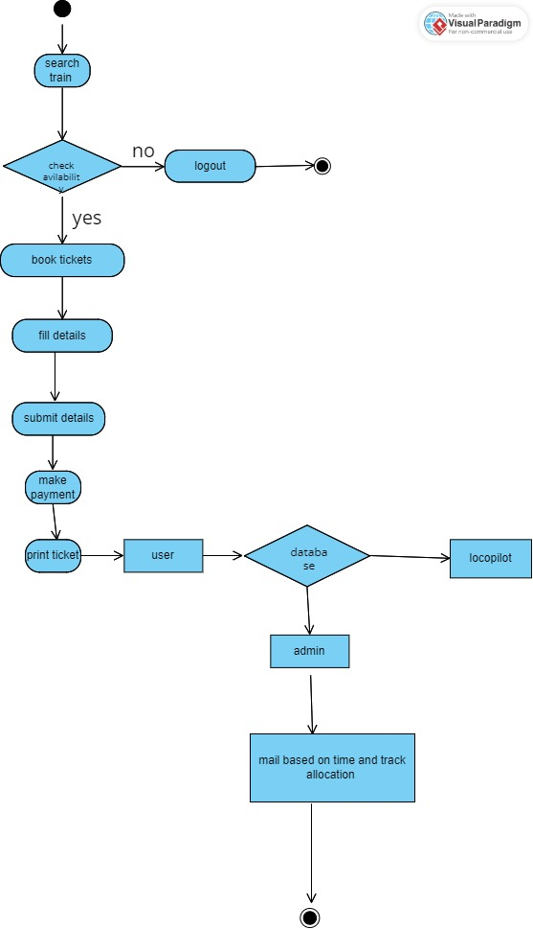
System Design - Activity diagram

Slide 20
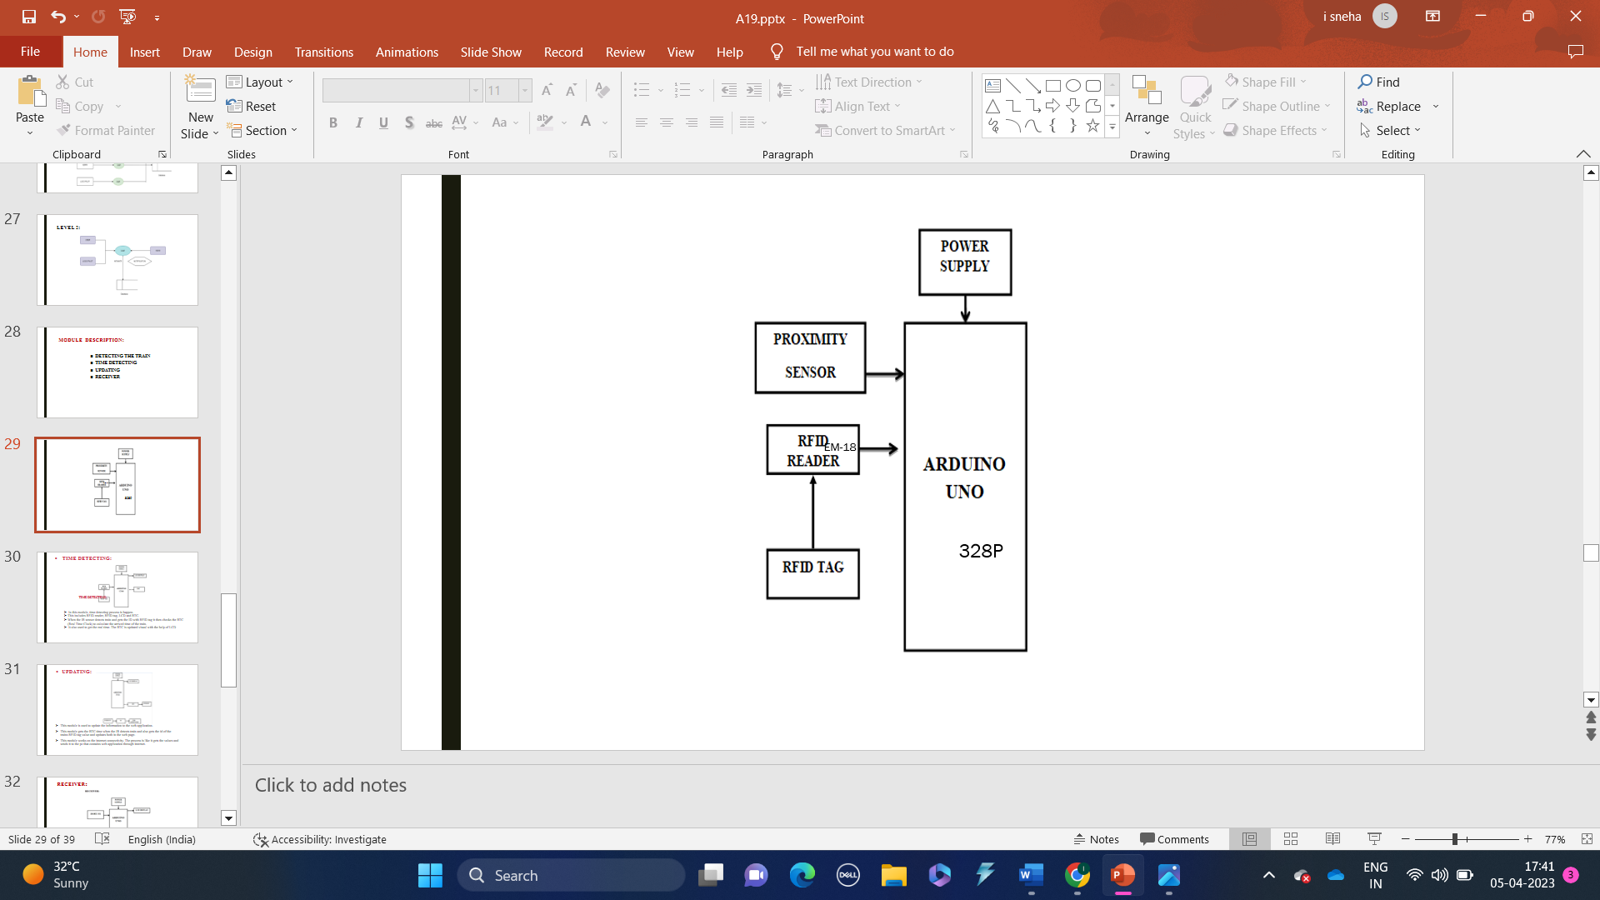
Module Description
1. Detecting the Train:
In this module detection of the Train is happening. In this we use IR sensor, RFID reader and RFID tag.
We use IR sensors to detect the train that arrives on the platform. The RFID tag is placed in the train to identify which train is arriving.
The RFID reader is placed in the station to read the RFID tag. This module helps to detect which train is Arriving.

Slide 21
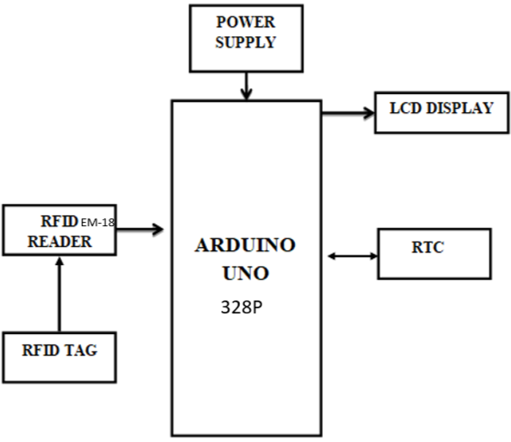
2. Time Detecting:
In this module, time detecting process is happening.
This includes RFID reader, RFID tag, LCD and RTC.
IR sensor detects the train and gets the ID with RFID tag and then it checks the RTC (Real Time Clock) to calculate the arrival time of the train.
It also used to get the real time. The RTC is updated visually with the help of LCD.

Slide 22
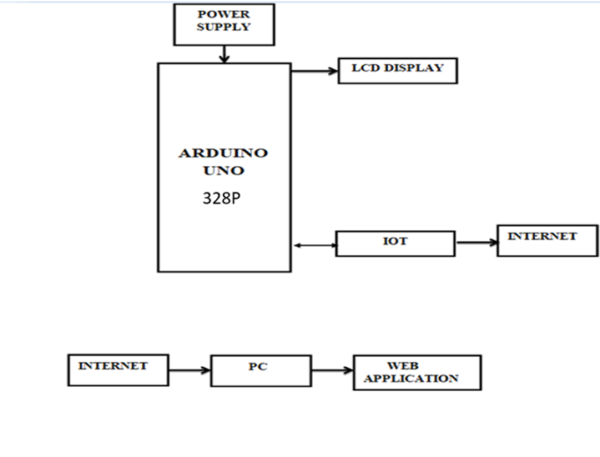

3. Updating:
This module is used to update the information to the web application.
This module gets the RTC time when the IR detects train . It also gets the id of the train with RFID tag value and updates both in the web page.
This module works on the internet connectivity. The process is like it gets the values and sends it to the pc that contains web application through internet.

Slide 23
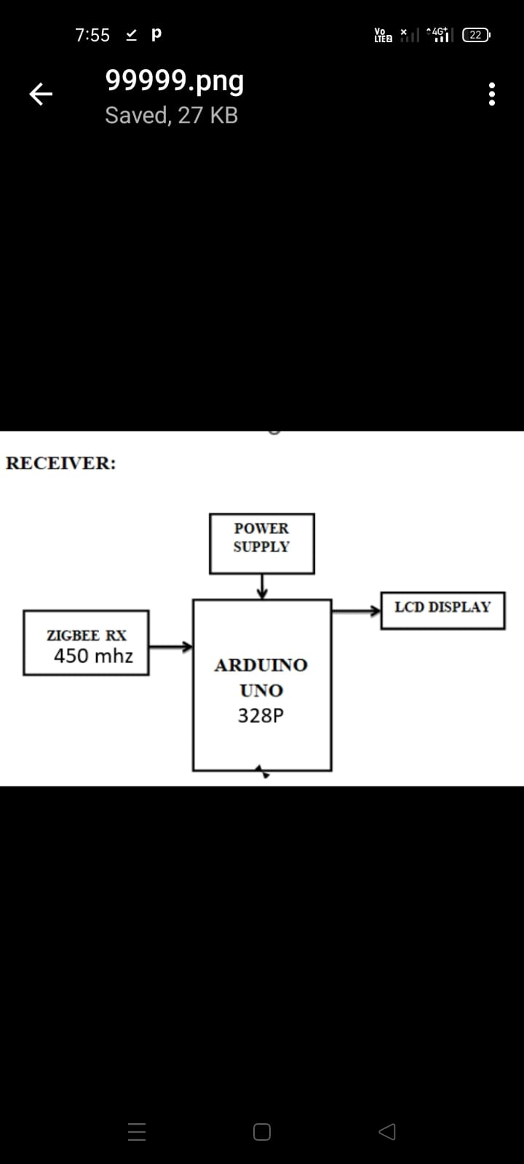
4. Receiver:
In this module, the ZIGBEE receiver , power supply, LCD are connected with Arduino UNO.
This module is present in the train for updating the information to the co-driver. This module sends time through the ZIGBEE module and the train time is updated to the LCD for co-driver.

Slide 24
Testing
Module Name: Detecting The Train
TEST CASE ID | TEST CASE | INPUT | EXPECTED OUTPUT | ACTUAL OUTPUT | RESULT
TC01 | Train Detection | IR sensor, RFID reader, RFID Tag | IR sensors should detect the train that arrives on the platform. (Scr 1) | IR sensor detects the train that arrives on the platform. (Scr 1) | Pass
Module Name: Time Detecting
TEST CASE ID | TEST CASES | INPUT | EXPECTED OUTPUT | ACTUAL OUTPUT | RESULT
TC01 | To detect the train and mail the passengers about the early arrival of train | RFID Tag, RFID reader, RTC, LCD | Train along with time should be detected and passengers should receive mail from admin (Scr 5) | Train along with time is detected and passengers received mail from admin (Scr 5) | Pass

Slide 25
Testing
TC02 | To detect the train and mail the passengers about the delay arrival of train | RFID tag, RFID reader, RTC, LCD | Train along with time should be detected and passengers should receive mail from admin (Scr 6) | Train along with time is detected and passengers received mail from admin (Scr 6) | Pass
TC03 | To detect the train and mail the passengers about the On-Time arrival of train | RFID tag, RFID reader, RTC, LCD | Train along with time should be detected and passengers should receive mail from admin (Scr 7) | Train along with time is detected and passengers received mail from admin (Scr 7) | Pass

Slide 26
Testing
Module Name: Updating
TEST CASE ID | TEST CASE | INPUT | EXPECTED OUTPUT | ACTUAL OUTPUT | RESULT
TC01 | To Update the information (Train Time, ID) to the Web App | RTC, RFID Tag, RFID Reader | Information should be updated to web application (Scr 8) | Information Updated to Web App (Scr 8) | Pass
Module Name : Receiver
TEST CASE ID | TEST CASE | INPUT | EXPECTED OUTPUT | ACTUAL OUTPUT | RESULT
TC01 | Updating the Train information (Unexpected train arrives in same track) to the Loco -Pilot through mail | ZIGBEE RX,RFID Tag, RFID reader | Loco Pilot should receive mail from admin (Scr 9) | Loco Pilot received mail from admin (Scr 9) | Pass

Slide 27
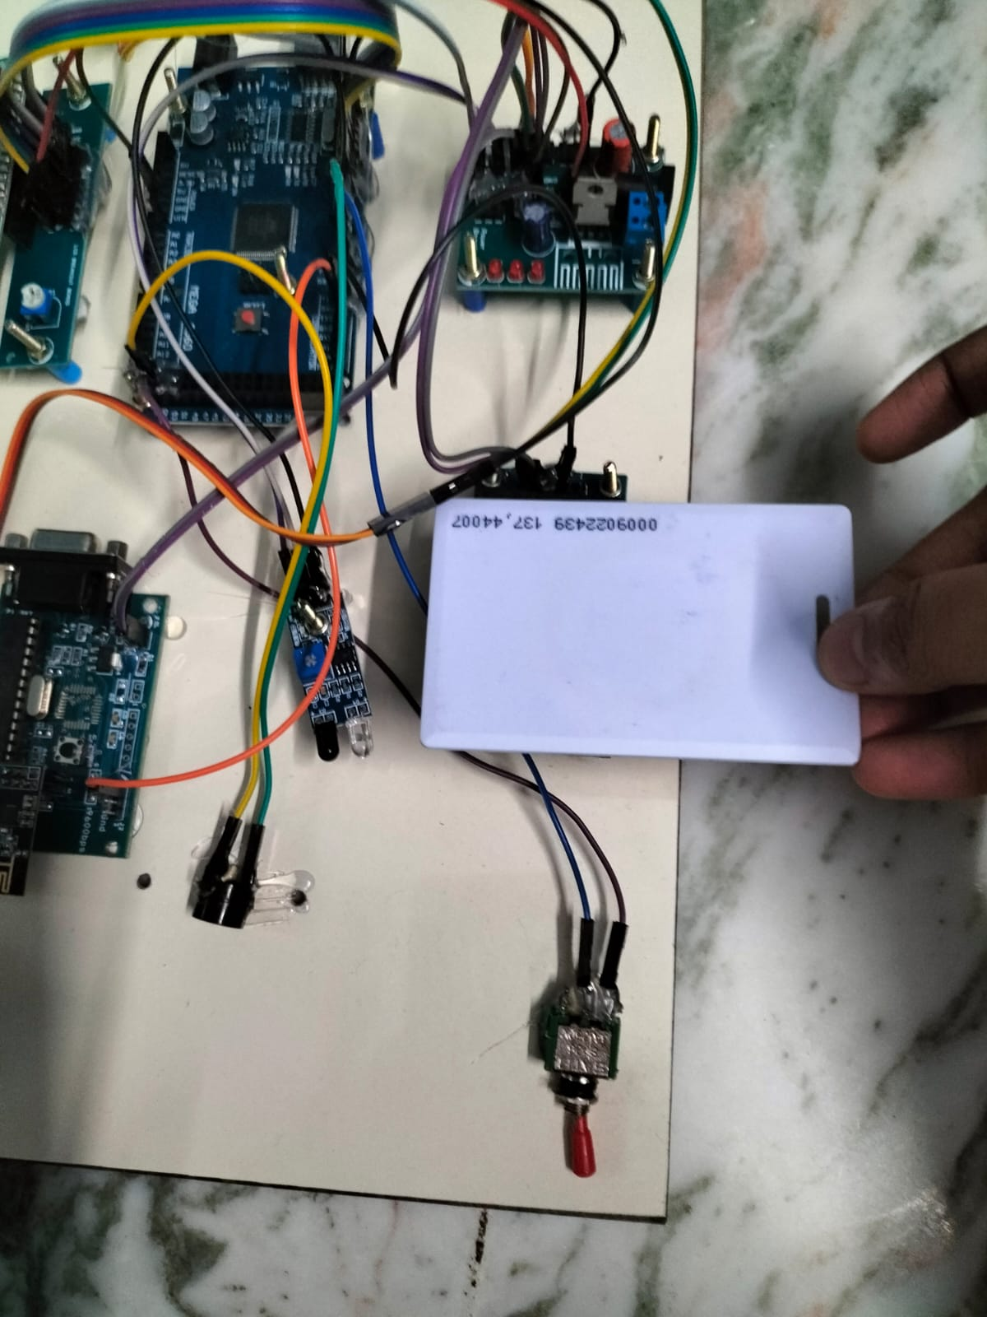
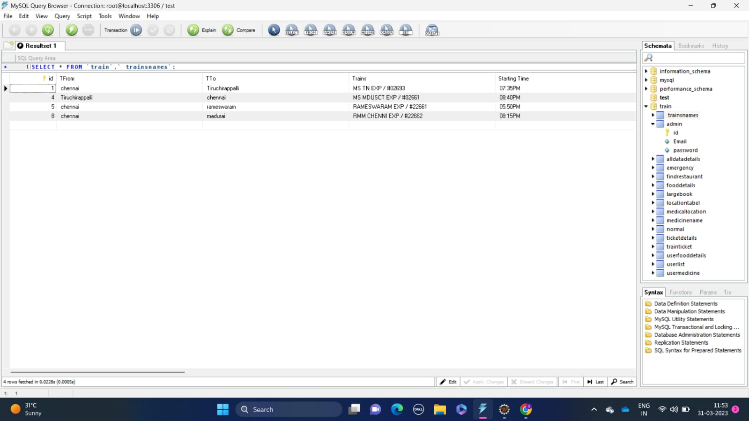
Screen Shots
1. Train Detection
2. Train Database

Slide 28

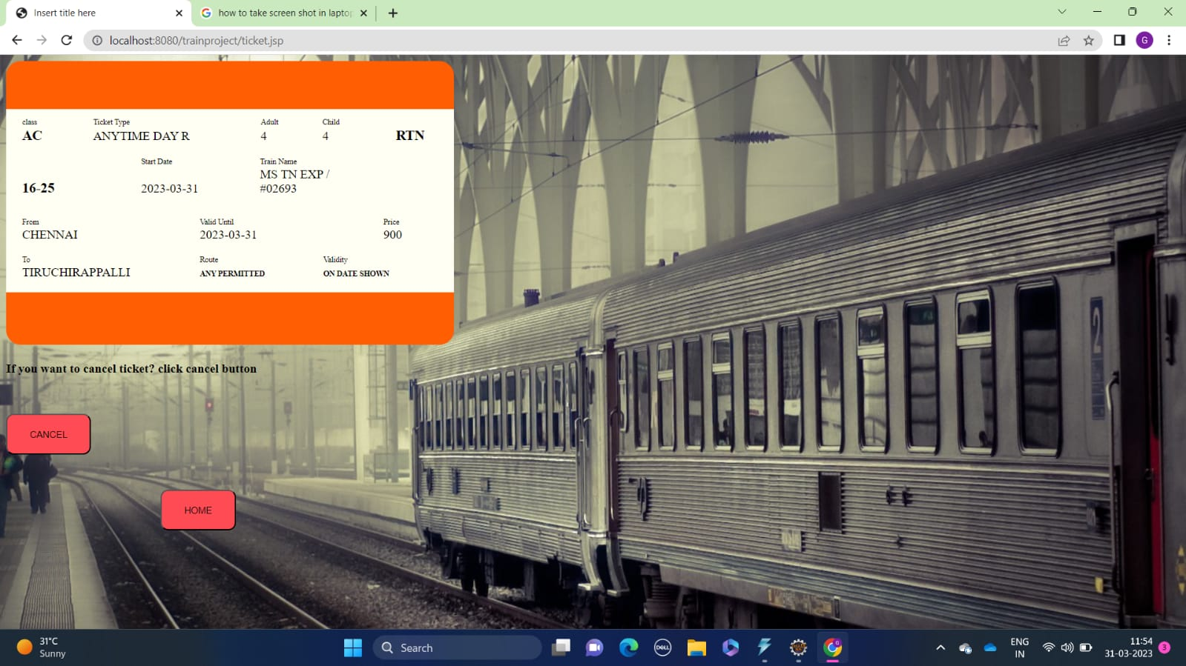
Screen Shots
3. Admin Page
4. User Booking Train Ticket

Slide 29
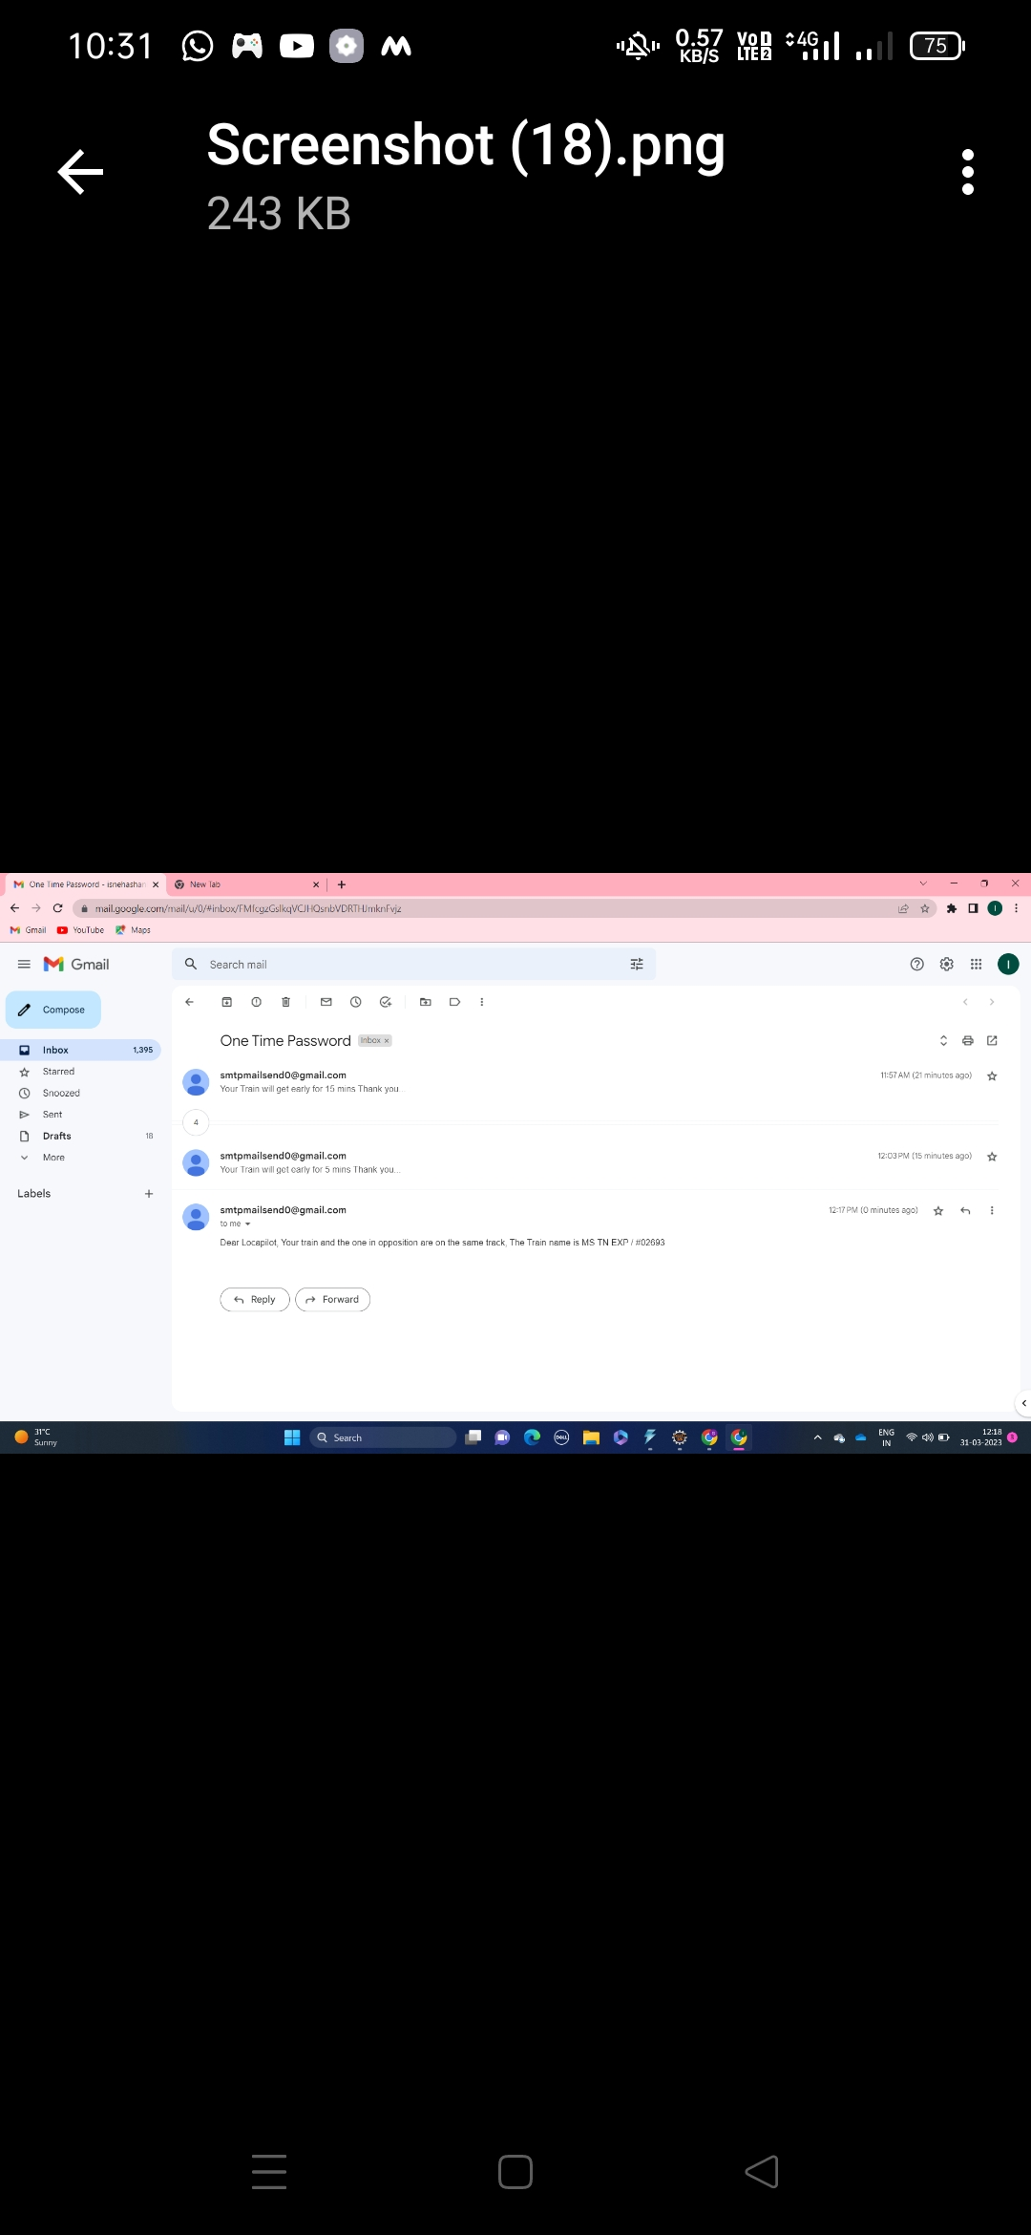
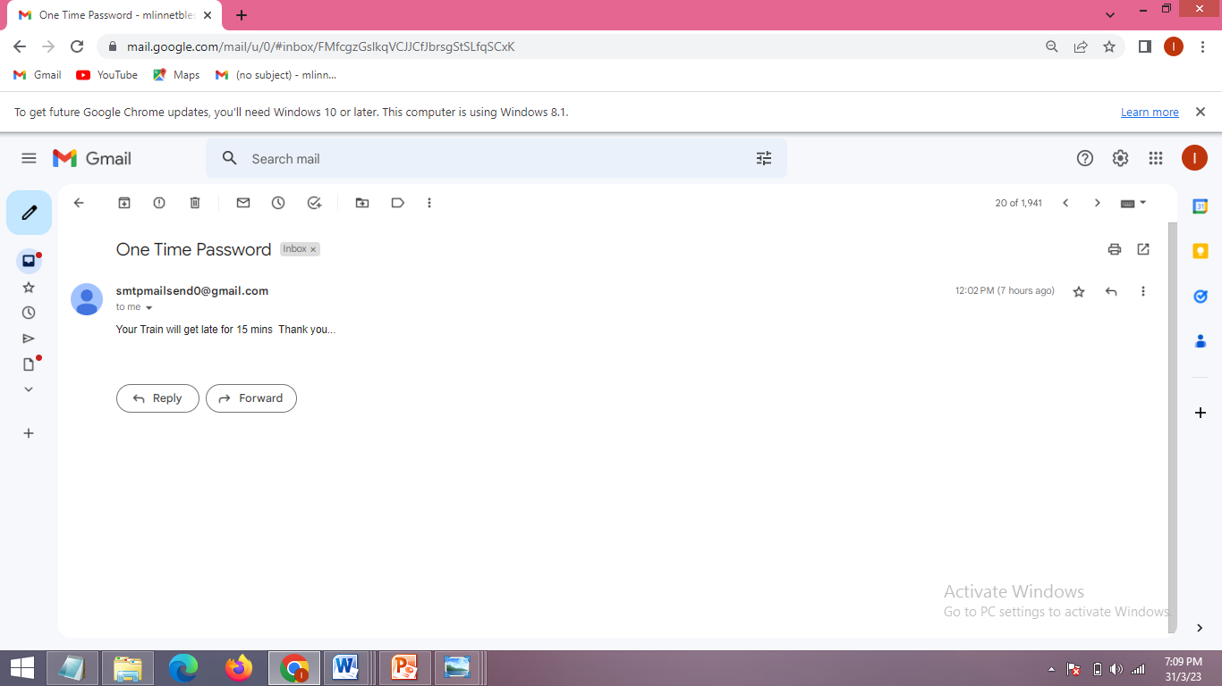
Screen Shots
5. Message For Early Arrival Of Train
6. Message For Delay Arrival Of Train

Slide 30
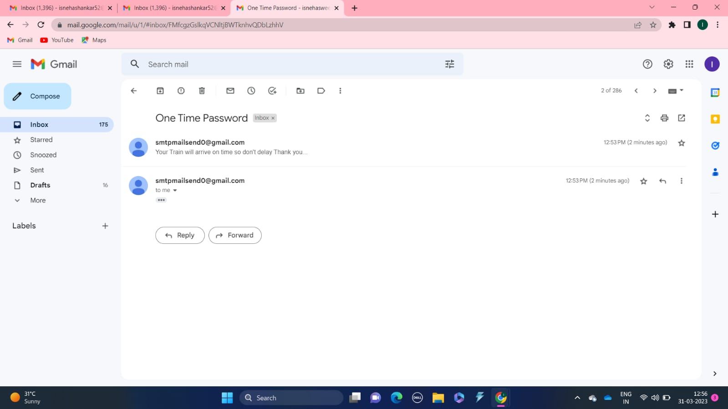
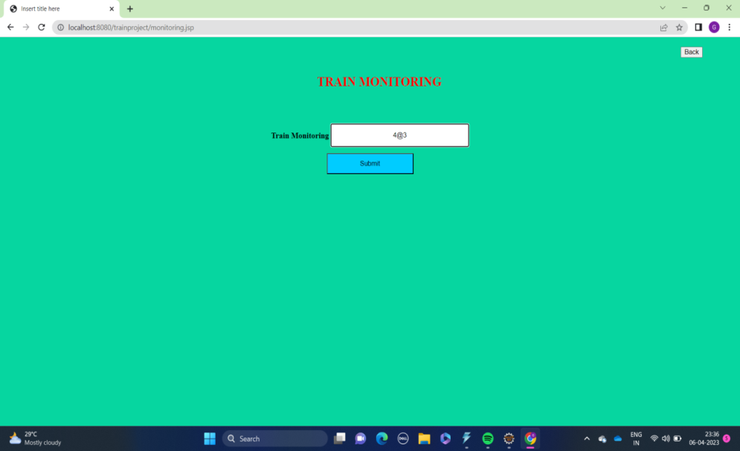
Screenshots
7. Message For On-time Arrival Of Train
8. Updating Train Information To Web App
9. Message For Track Allocation To The Loco Pilot

Slide 31
Conclusion
Rail transportation is acknowledged as an energy-efficient (though capital-intensive) and environmentally friendly mode of transportation. This project focuses on improving train schedules on railway networks. We attain our goal with the aid of an embedded system. The sensor approach is used to create this paradigm. This device detects the arrival time of the train using sensors ,RTC , RFID reader ,Tag. Railways may be made more appealing to travellers by lowering waiting times, accidents, and increasing the number of services and timeliness i.e punctuality. It is helpful to intimate to the passengers whether the train arrives to the station on time , if another train arrives in same track it will intimate Loco Pilot through mail. And also helps to update the information with respected id’s. In future we can add alert if the train is delay. And also we can make the whole system is controlled by AI.

Slide 32
Reference Paper
Hafeez Ur Rehman Siddiqui , Adil Ali Saleem, Muhammad Amjad Raza, Kainat Zafar,Kashif Munir,Sandra Dudley,” Iot Based Railway Track Faults Detection And Localization Using Acoustic Analysis”,2022.
Alan Shaju,Aravind Madhu , Doel Sam,“Automated railway track crack detection system”2022.
Yanqiu Li,Xinyue Xu , Jianmin Li,Rui Shi ,“A Delay Prediction Model For High-Speed Railway”2020.
Hamad Alawad, Sakdirat Kaewunruen, Min An, “A Deep Learning Approach Towards RailwayAssessment”2020.
Qi Zhang, Zhiming Yuan, Lu Yan, Tao Zhang, Yifeng Miao, Shuxin Ding"A Railway Train Number Tracking Method Using A Prediction Approach",2019.

Slide 33
Y. Baviskar, U. Suryawanshi, A. Sheikh ,” Modelling of Track Layout for Intelligent Railway Signalling System: A Machine Learning Application”2018
DR.R.Velayutham,T.Sangeetharani,K.Sundaralakshmi”Controlling Railway gates using smart phones by tracking trains with GPS”2017
Dr. F. Balouchi,Dr. A. Bevan,R. Formston,"Detecting Railway Under-track Voids Using Multitrain In-service Vehicle Accelerometer",2017
Sarngadi Palgunadi,Dian Supraba , Bambang Harijito"Job-shop Scheduling Model For Optimization Of The Double Track Railway Scheduling"2016
J.Guo,X.Wang,Y.Zhang,Y.Yang,” Future prospects on the intelligent monitoring technologies for Railway Signalling system”2014

